Slide 1


HAVE YOU EVER ....

Slide 2

mobile - based logistics System
with Smart Routing and Tracking Services
City University of Hong Kong
Final Year Project 2020-2021
Wu Kai On (55216397)

Slide 3
TABLE OF CONTENTS
1
2
3
Project background
Methodology
Comparison
4
5
6
Complexity
Results and
Novel parts
Conclusion

Slide 4
Project Background
Online Shopping
E - commerce
Service QUALITY
reliable
manageable

Slide 5
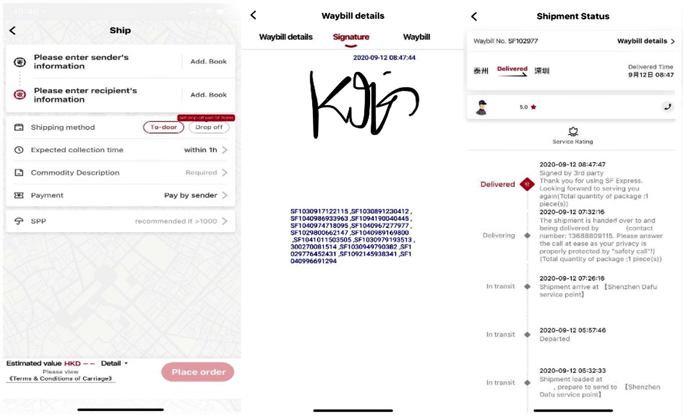
Comparison
SF Express

Slide 6
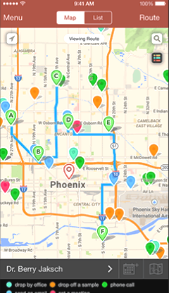
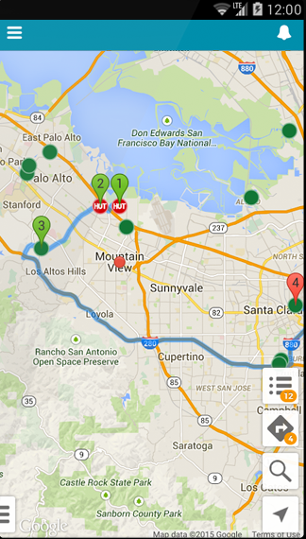
Comparison
gEOPOINTE

Slide 7
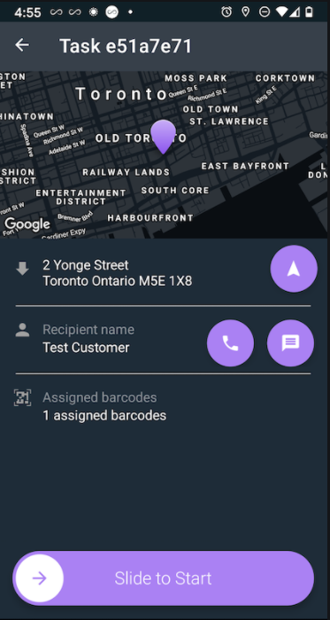
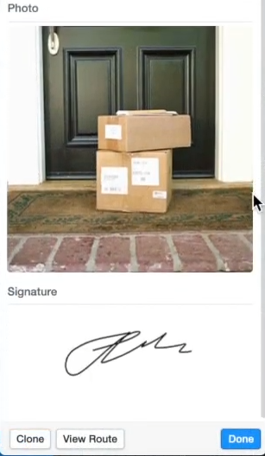
Comparison
onfleet

Slide 8
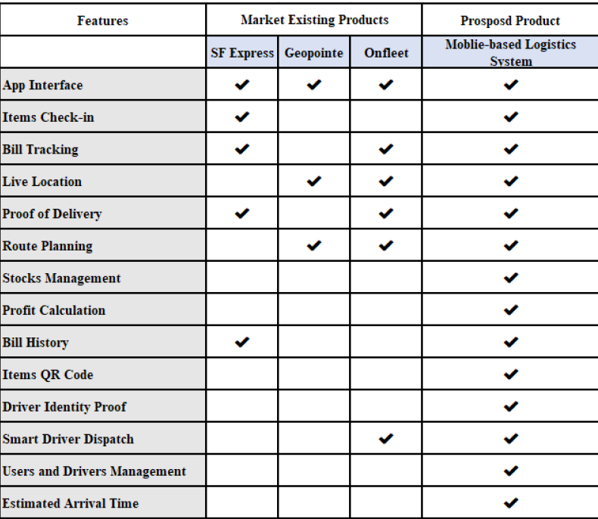
Comparison

Slide 9
Logistics system
Predictable - Estimated Arrival Time
User - friendly - Reactive and Clean Interface
Trustworthy - Manageable and Functional
Cost Efficient - For small - scale logistics businesses

Slide 10
Bill Tracking
Dispatching
Management
Proof of delivery
Live Location
Items Online Check-In
Smart Jobs Assignment
Optimal Routing
Delivery Items
Drivers and Users
E - signature
QR Code

Slide 11
User Check-in Item
Driver Register Jobs
Item Tracking
Admin Assign Jobs
Optimal Routing
Process Items

Slide 12
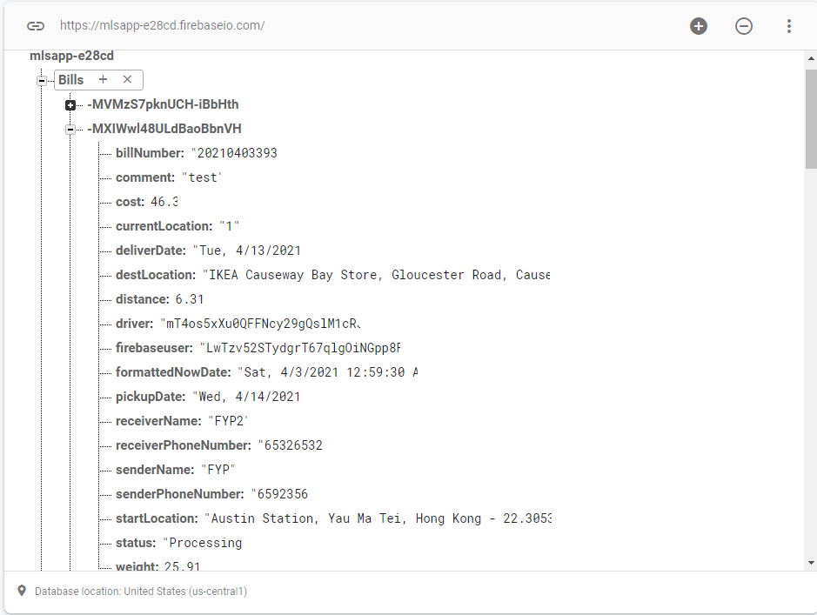
Methodology
Database and Application Structure
Flutter, Android - 3 Interfaces
Firebase Realtime Database
Authentication

Slide 13

Real-time bill tracking
Periodically Retrieve Driver’s Location
Real-time update
Estimated Arrival Time

Slide 14
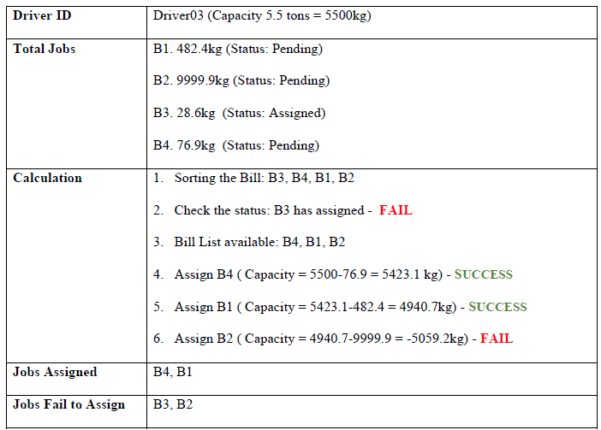

Smart Jobs Assignment
Bin Packing Problem
Modified First Fit Algorithms
Check the status of the Bills

Slide 15
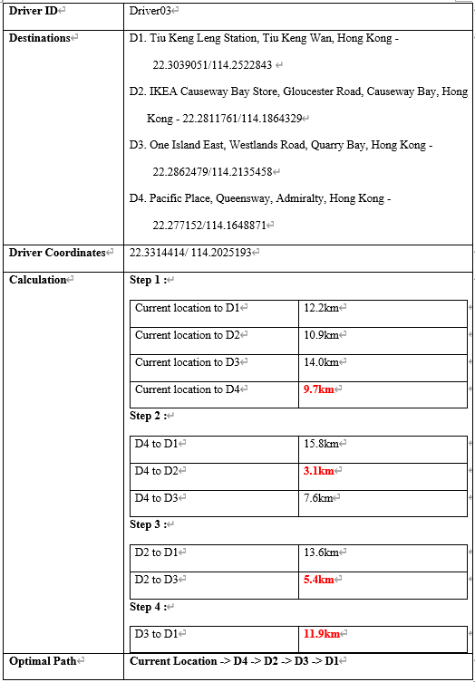
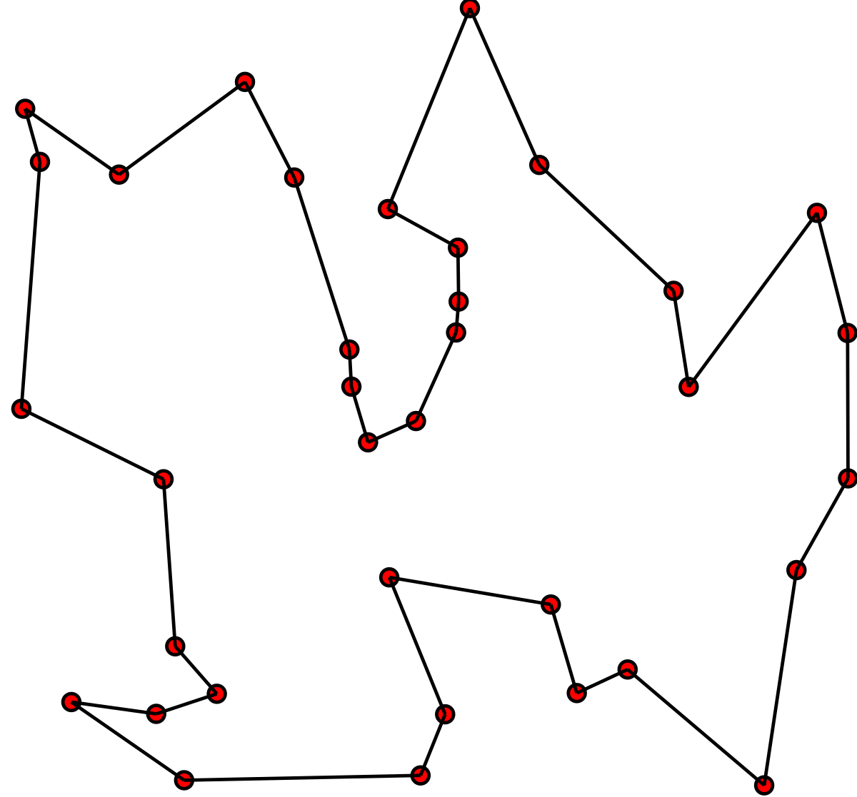
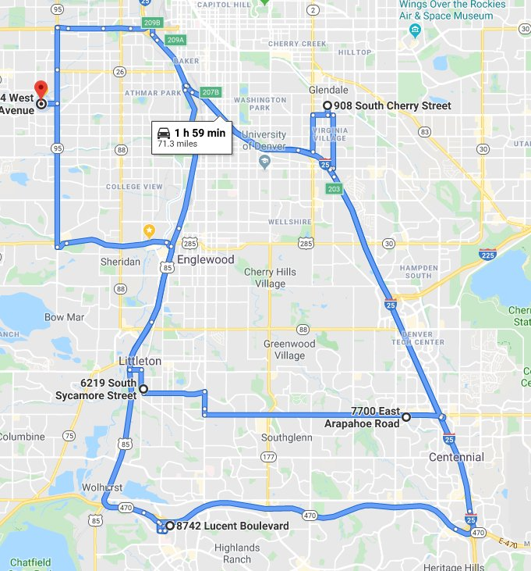
Optimal Routing
Travel Salesman Problem
Retrieve the Driver Location
Keep finding the nearest destinations

Slide 16

QR Code and Signature
Make use of Flutter packages
Secure the item process
Upload to Firebase Storage

Slide 17
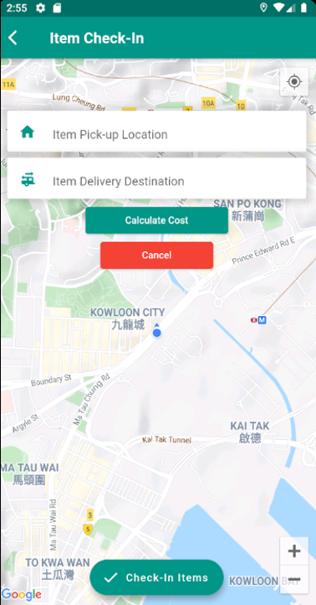
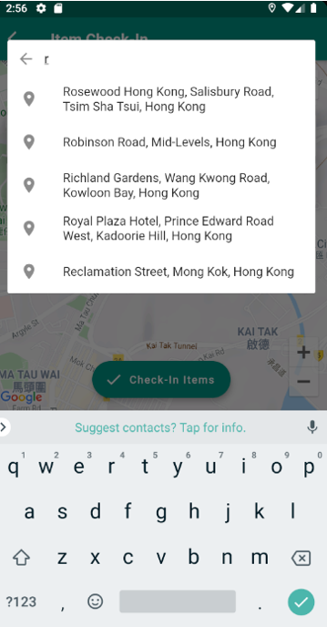
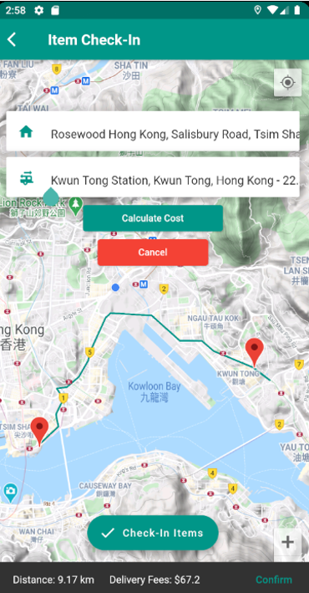
Results and Novel parts
Items Check-in Function

Slide 18
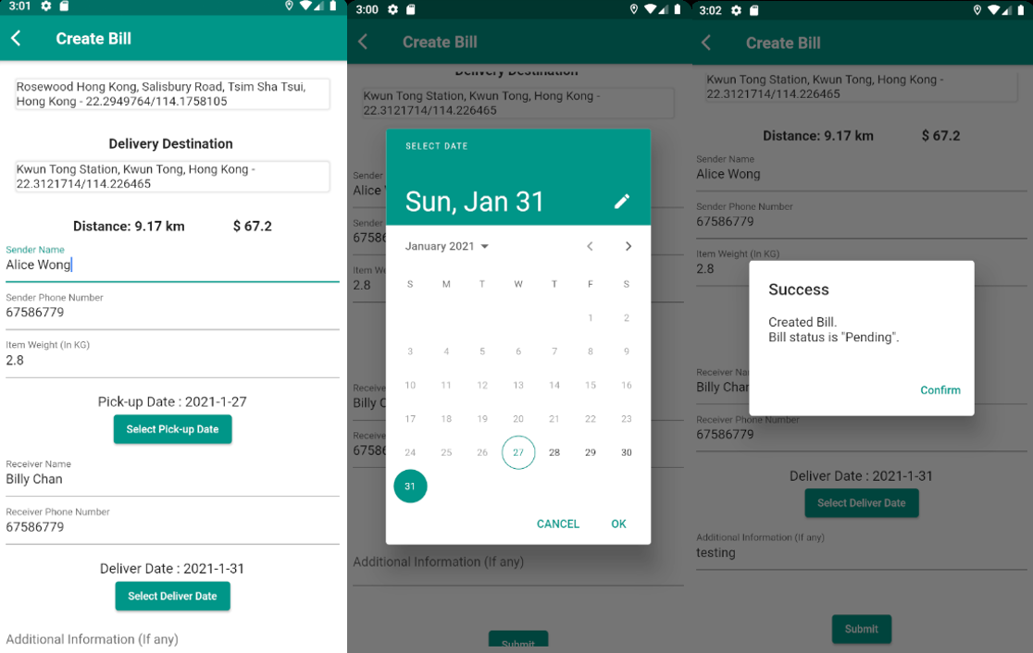
Items Check-in Function

Slide 19
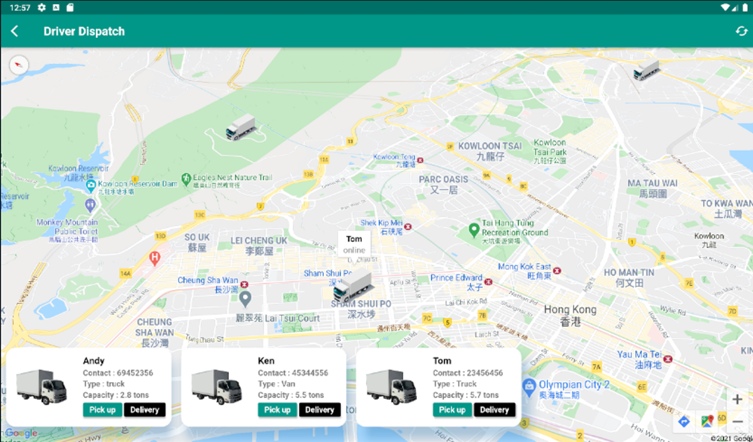
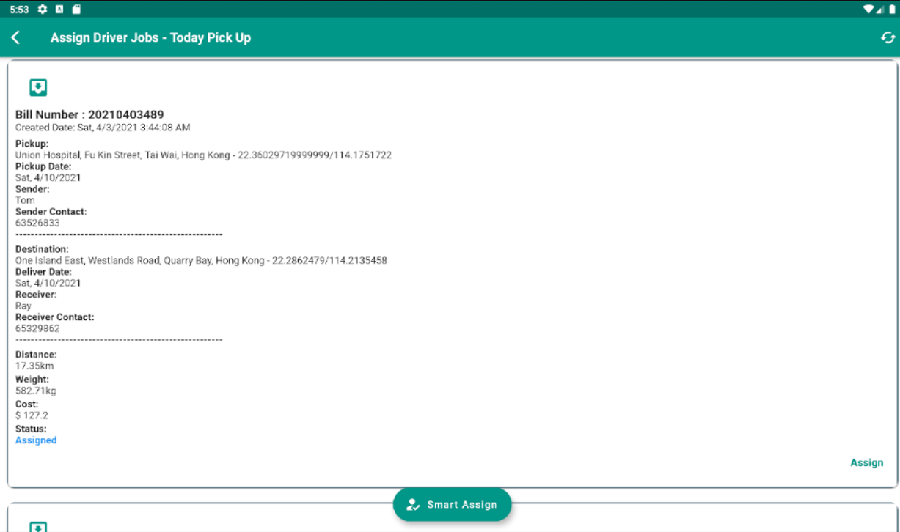
Smart Jobs Assignment

Slide 20
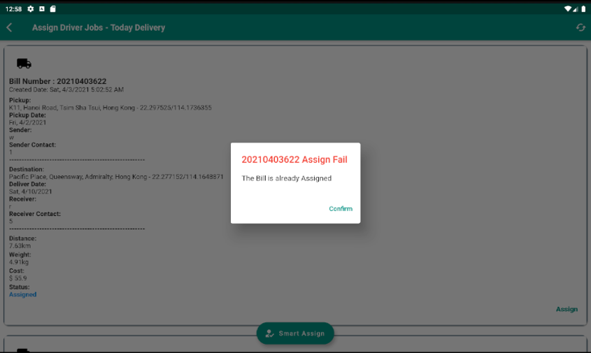
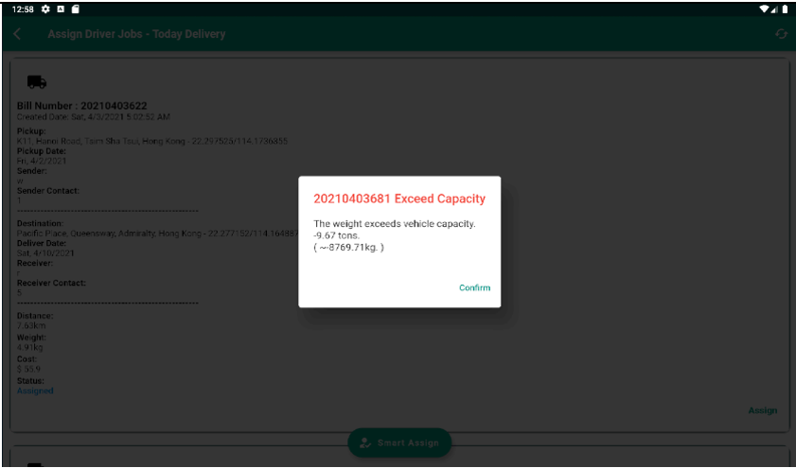
Smart Jobs Assignment

Slide 21
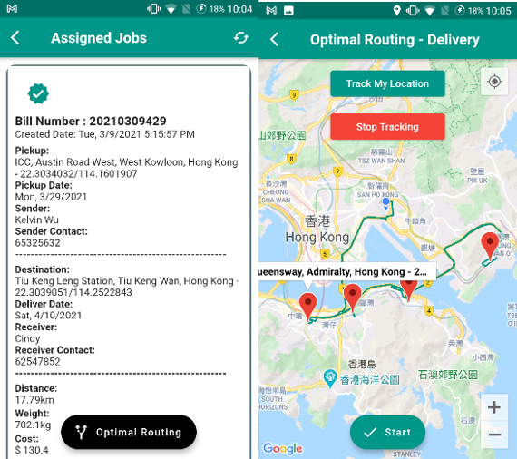
Optimal Routing

Slide 22
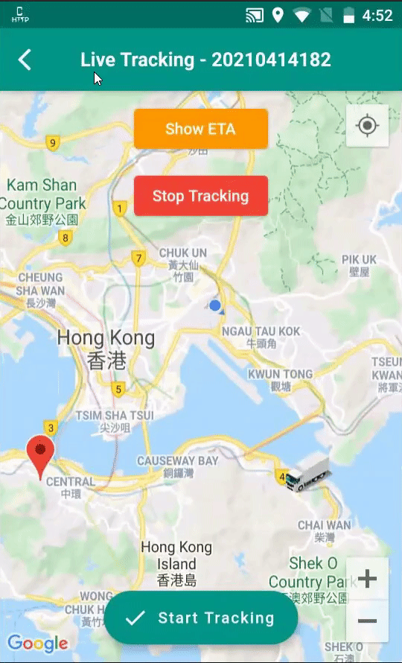
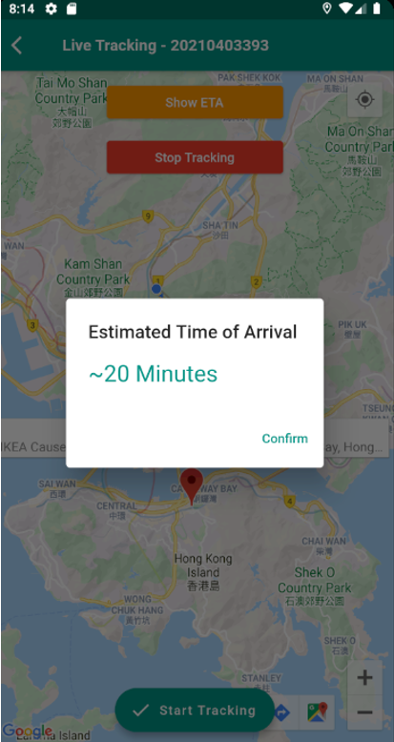
Bill Tracking

Slide 23
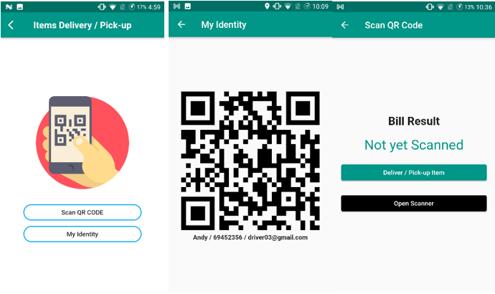
Proof of Delivery

Slide 24
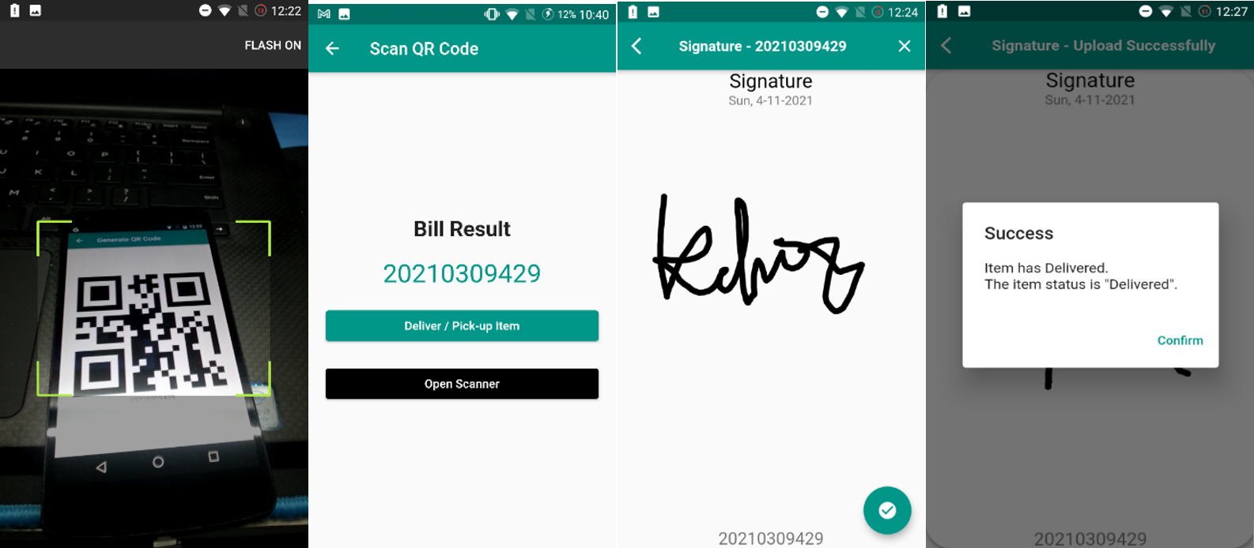
Proof of Delivery
Proof of Delivery

Slide 25
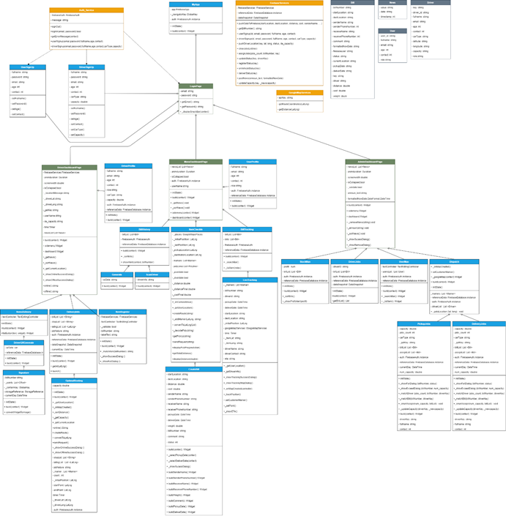
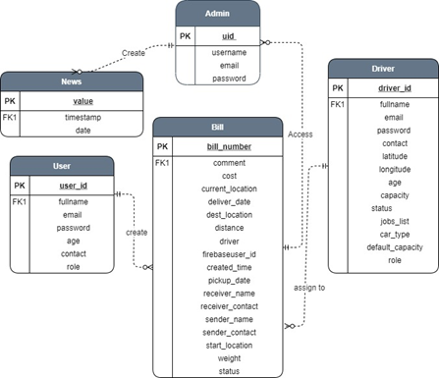
Complexity
Class and Interfaces
More than 40 Classes
API calls and Database references
Handle Application State
Attributes and Bills Status

Slide 26
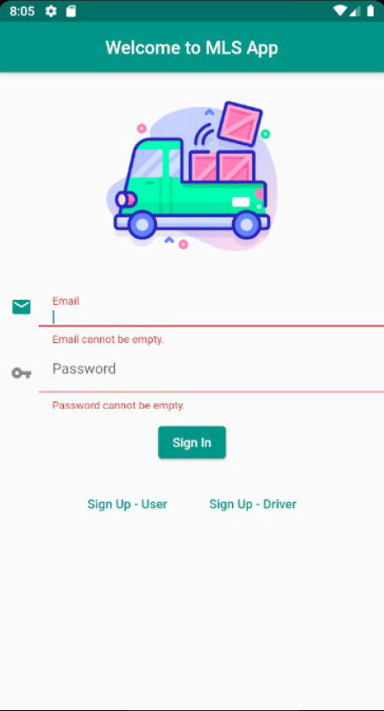
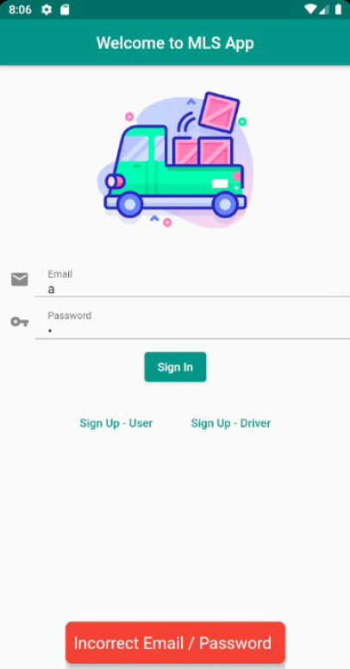
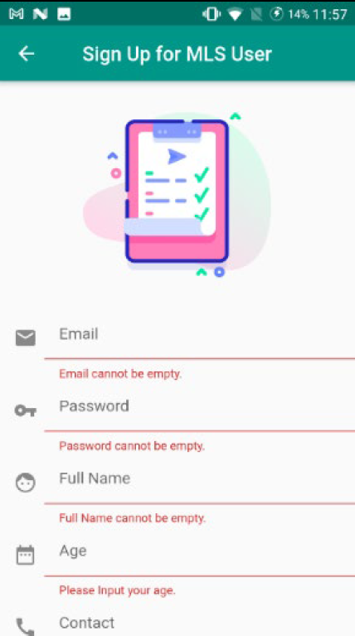
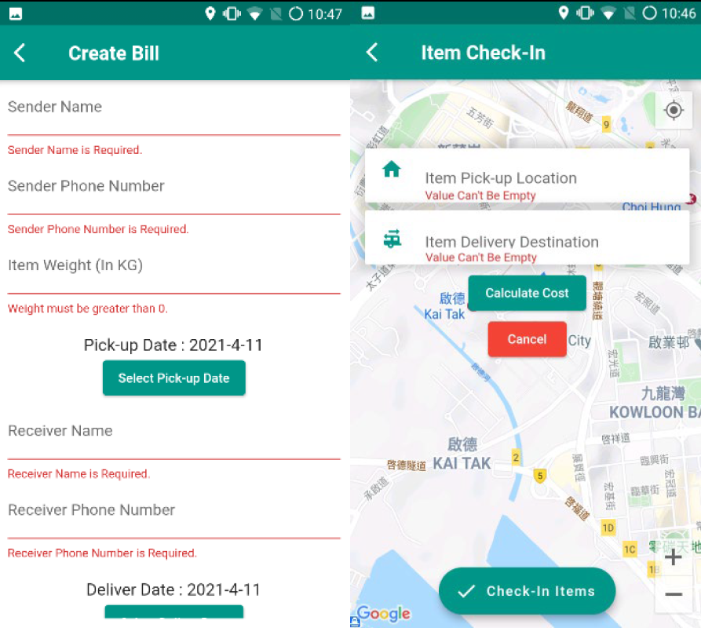
Complexity
Exceptions Handling

Slide 27
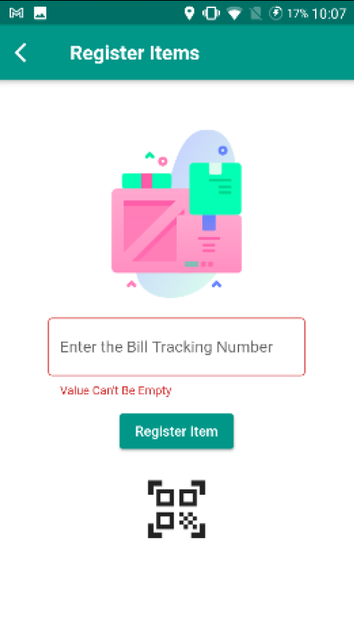
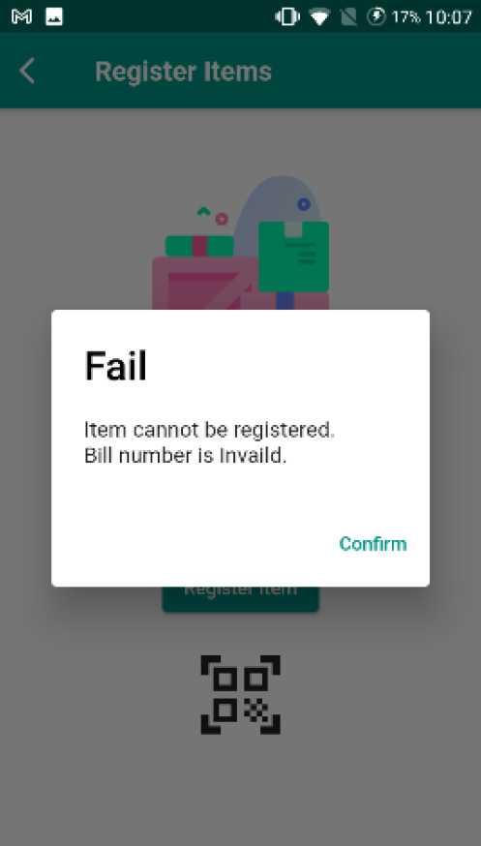
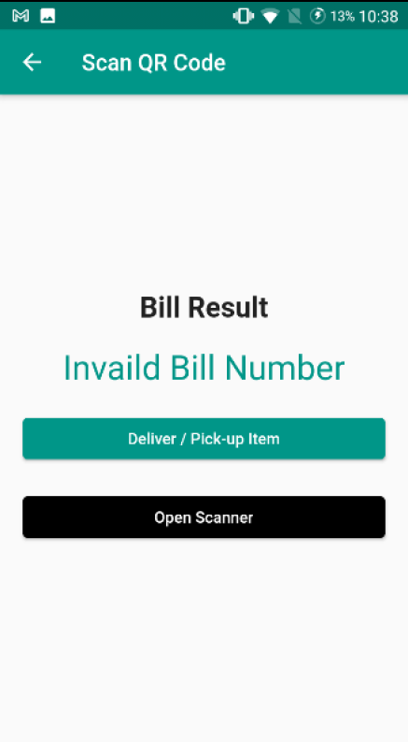
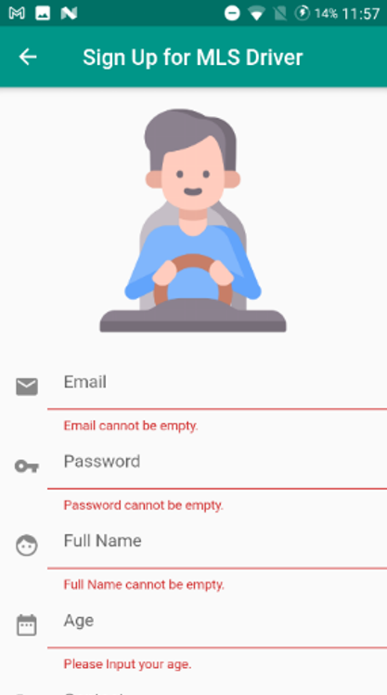
Complexity
Exceptions Handling

Slide 28

Complexity
Algorithms, Functions and Application Design
Jobs Assignment
Optimal Routing
Real-time Checking
Reactive and Responsive
Time Management

Slide 29
Conclusion
Mobile-based Logistics Management System
Online Check-in and Bill Tracking
Optimal Routing
Smart Jobs Assignment
Easy Proof of Delivery
Transportation, Security, IoT

Slide 30
References
https://www.myanmore.com/2020/04/the-yangon-online-shopping-guide/
https://www.ignant.com/2018/12/12/the-art-of-waiting/
Christofids, Nicos. (1976) “Worst-case analysis of a new heuristic for the travelling salesman problem.” No. RR-388. Carnegie Mellon University Pittsburgh Pa Management Sciences Research Group

Slide 31
tHANK YOU !

